Slide 1
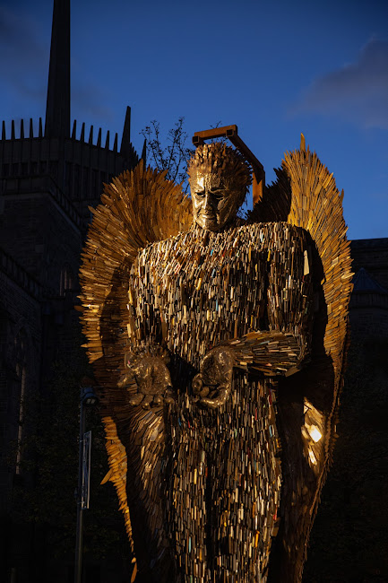
NATIONAL MONUMENT AGAINST VIOLENCE AND AGGRESSION
THE KNIFE ANGEL
Blackburn Cathedral
4th-29th November 2021

Slide 2
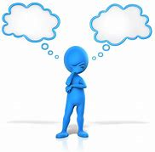
RESILIENCE …. What do we mean?
WHAT DO YOU THINK?

Slide 3
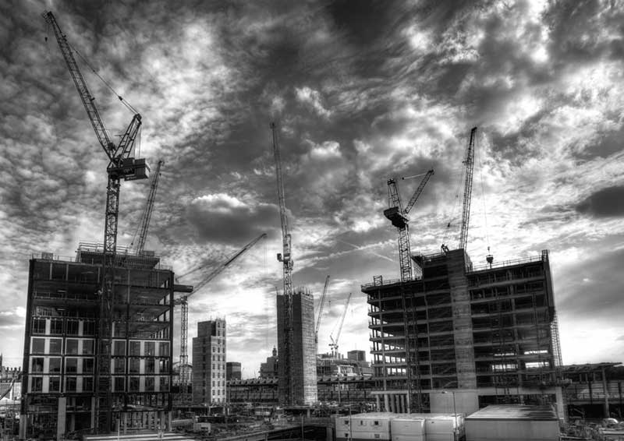
Building RESILIENCE…..
WHAT DO YOU THINK?

Slide 4
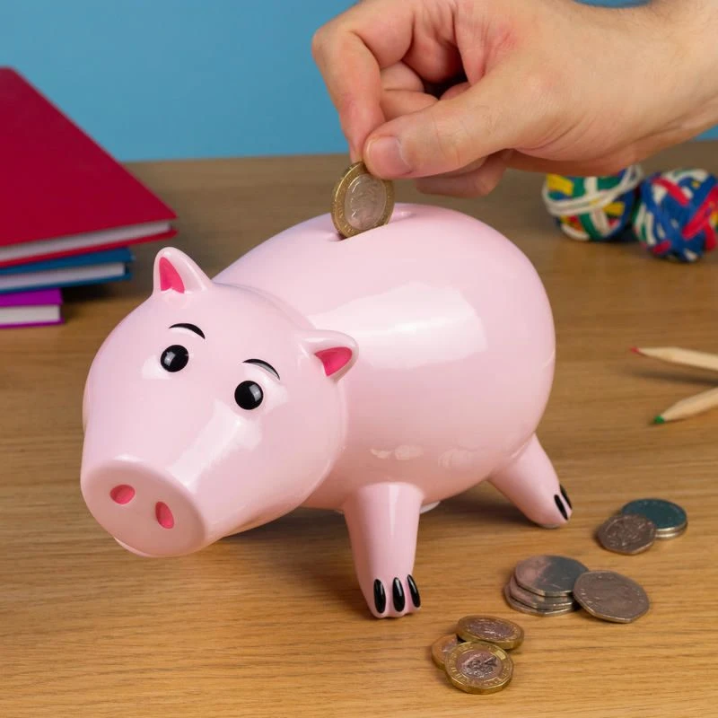
Building RESILIENCE…..
Building resilience is a bit like opening a bank account ……

Slide 5
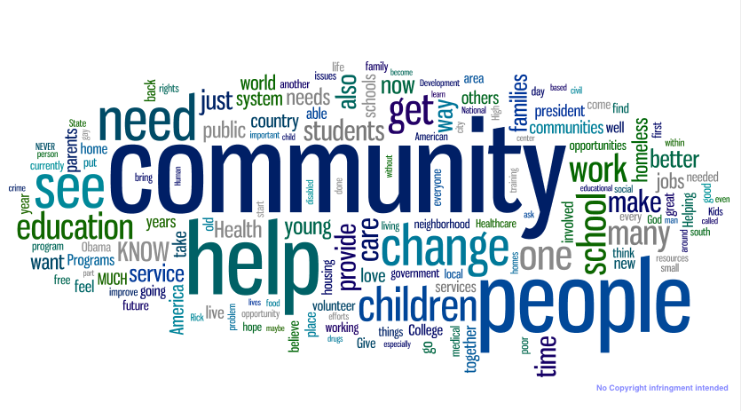
Building RESILIENCE…..
THE ROLE OF COMMUNITY

Slide 6
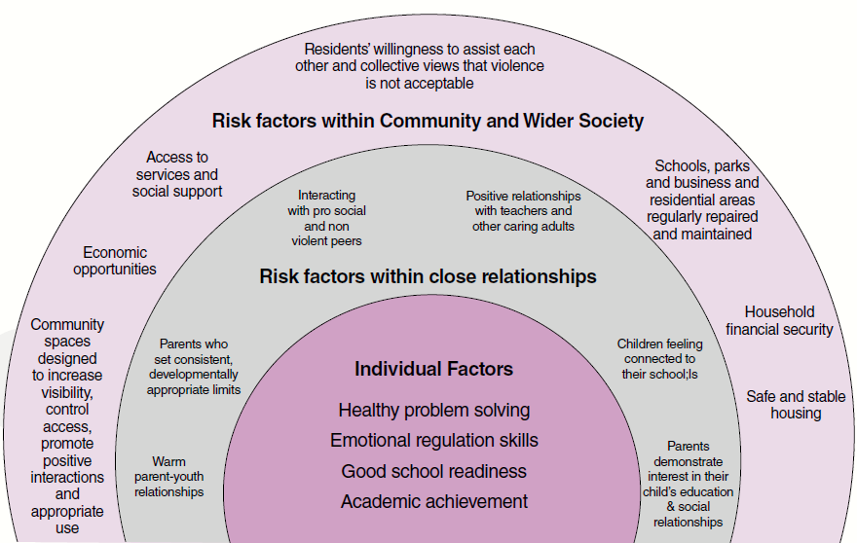
Building RESILIENCE…..
Protective factors within Community & wider Society
THE ROLE OF COMMUNITY
Protective factors within close relationships

Slide 7
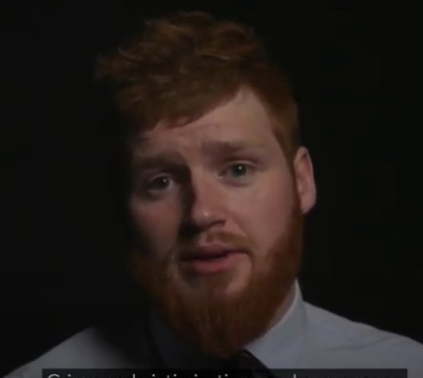
Building RESILIENCE…..
Additional Resources
https://www.youtube.com/watch?v=lKhf1o7zrKA
The Support Worker’s Story

