Slide 1
NATIONAL MONUMENT AGAINST VIOLENCE AND AGGRESSION
THE KNIFE ANGEL
Blackburn Cathedral
4th-29th November 2021

Slide 2
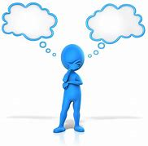
What do we mean by TRAUMA?
WHAT DO YOU THINK?

Slide 3
What do we mean by TRAUMA?
WHAT DO YOU THINK?

Slide 4
What do we mean by TRAUMA?
Trauma results from an event, series of events, or set of circumstances that is experienced by an individual as physically or emotionally harmful or life threatening and that has lasting adverse effects on the individual’s functioning and mental, physical, social, emotional, or spiritual well-being.
[Lancashire Violence Reduction Network - Trauma Informed Toolkit. May 2020]

Slide 5
What might cause TRAUMA?
WHAT DO YOU THINK?

Slide 6
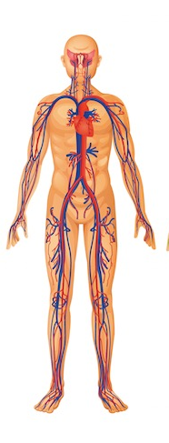
The impact of TRAUMA
ON OUR BODIES

Slide 7
The impact of TRAUMA
HEAD:
- Brain
- Mental Health
- Depression
LUNG DISEASE
EATING DISORDERS
STIs
HEART:
- Disease
- Attack
BROKEN BONES
DIABETES

Slide 8
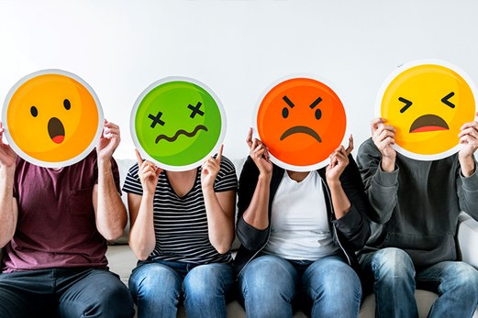
The impact of TRAUMA
ON OUR BEHAVIOUR

Slide 9
The impact of TRAUMA
Research evidence is that adults who have experienced trauma, especially in their childhood and have not had the resilience to counter this are:
14-15 x more likely to attempt suicide
4 x more likely to become an alcoholic
2 x the average level of liver disease
3-4 x more likely to experience depression
3 x more likely to be absent from work
4 x more likely to have begun intercourse by age 15
People with severe level of trauma can die up to 20 years earlier than the average
This does not mean that everyone who absent from work, for example, has some serious trauma – but these are some of the indicators that we may be seeing in adults who have experienced trauma
when they were younger.

Slide 10
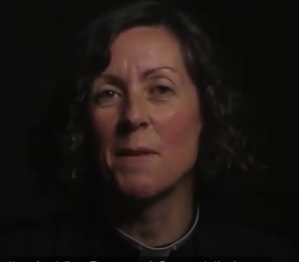
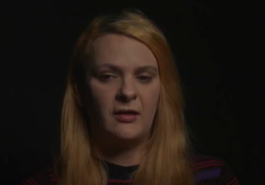
Trauma, Harm and Resilience Additional Resources
https://www.youtube.com/watch?v=8nxzlXb0608
The Family’s Story
https://www.youtube.com/watch?v=Nb25SFWI3LA
The Victim’s Story

